Slide 1
MER 532: Composite Materials
Review of Matrix Algebra
Square Matrices
Matrix Addition
Matrix Multiplication
Matrix Transpose
Determinants
Cofactor Matrix
Matrix Inversion
Eigenvalues and Eigenvectors
1

Slide 2
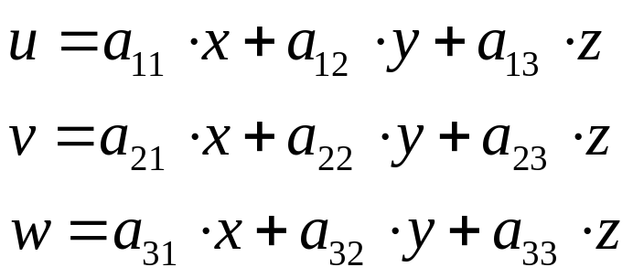
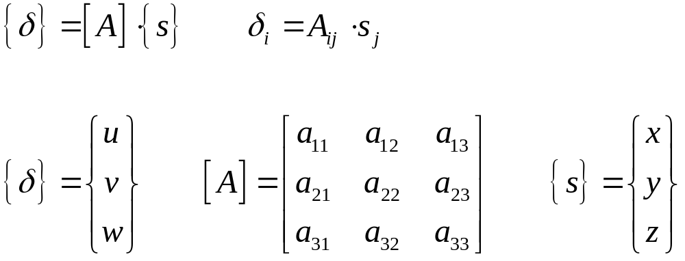
Matrix Algebra

Slide 3
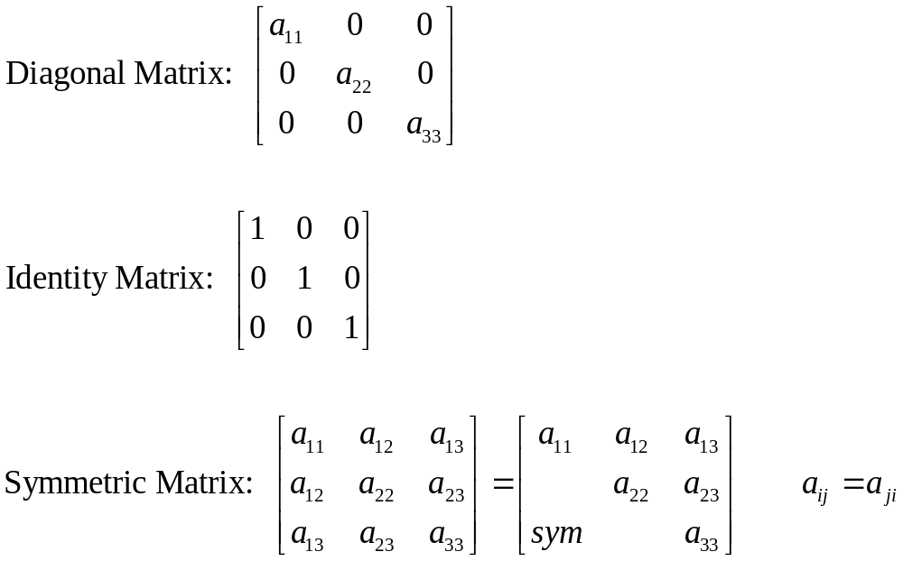
Types of Square Matrices

Slide 4
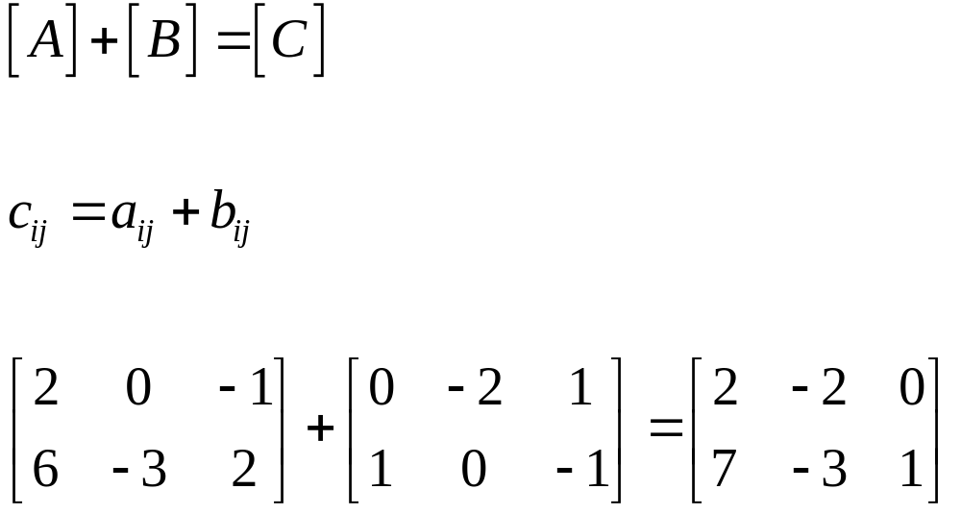
Matrix Addition

Slide 5
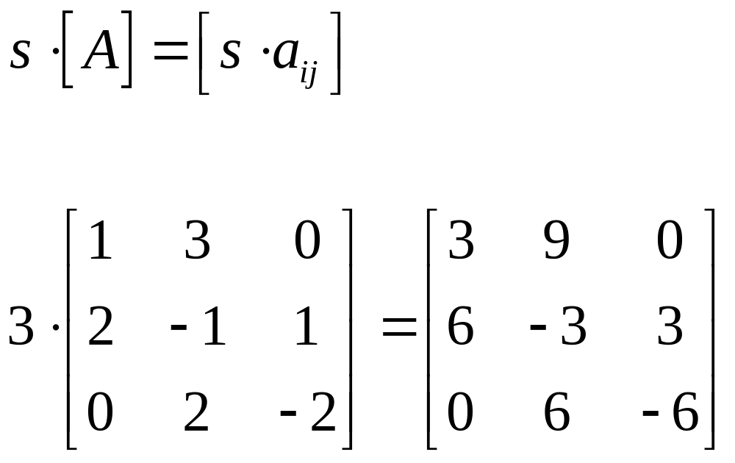
Scalar Multiplication

Slide 6
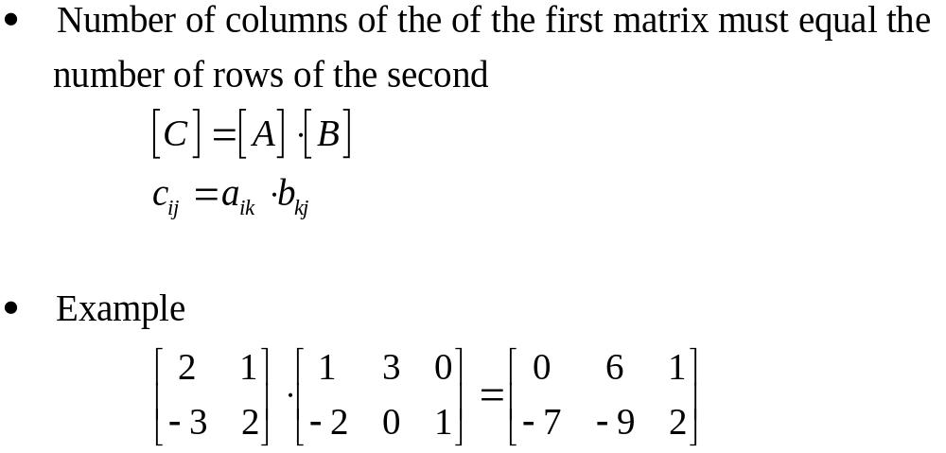
Matrix Multiplication

Slide 7
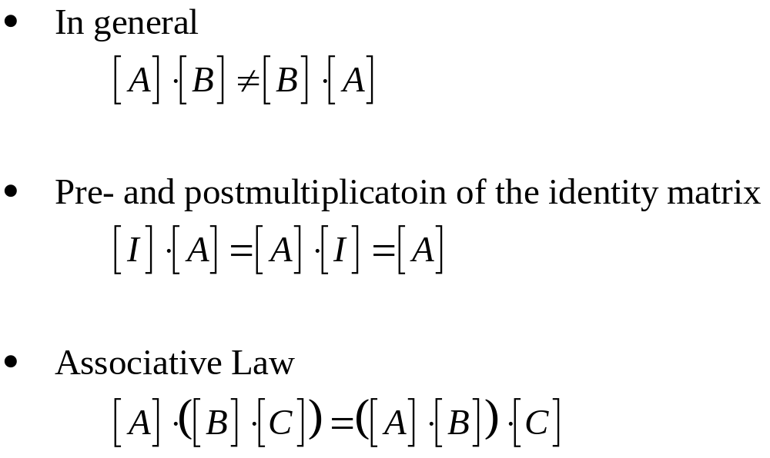
Matrix Multiplication of
Square Matrices

Slide 8
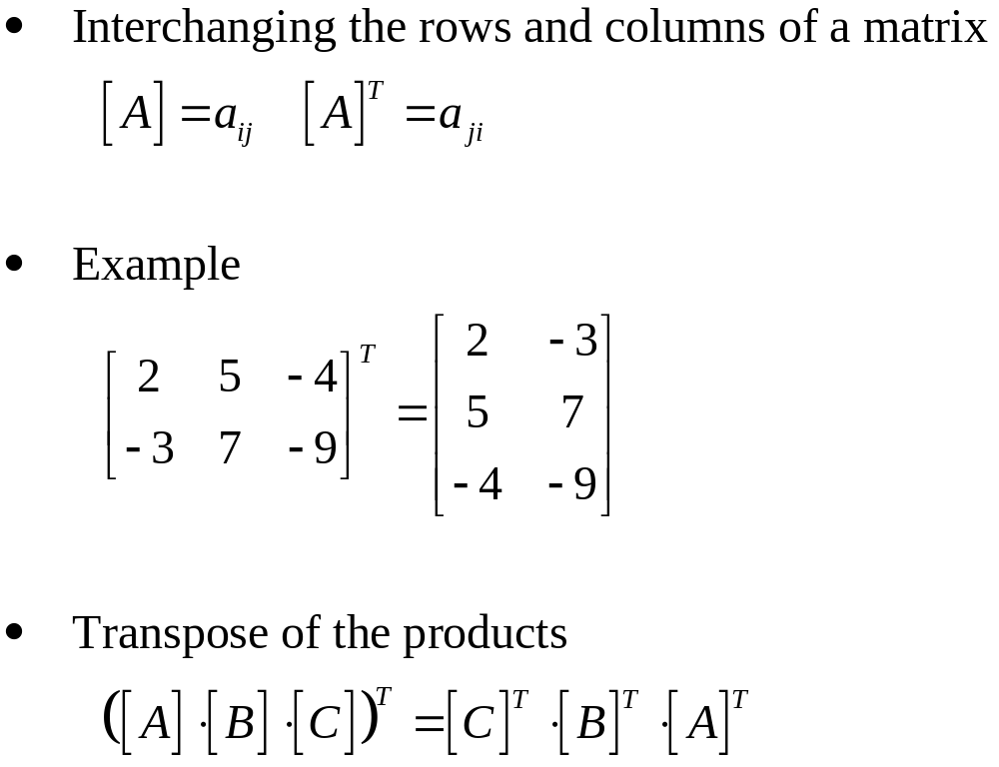
Matrix Transpose

Slide 9
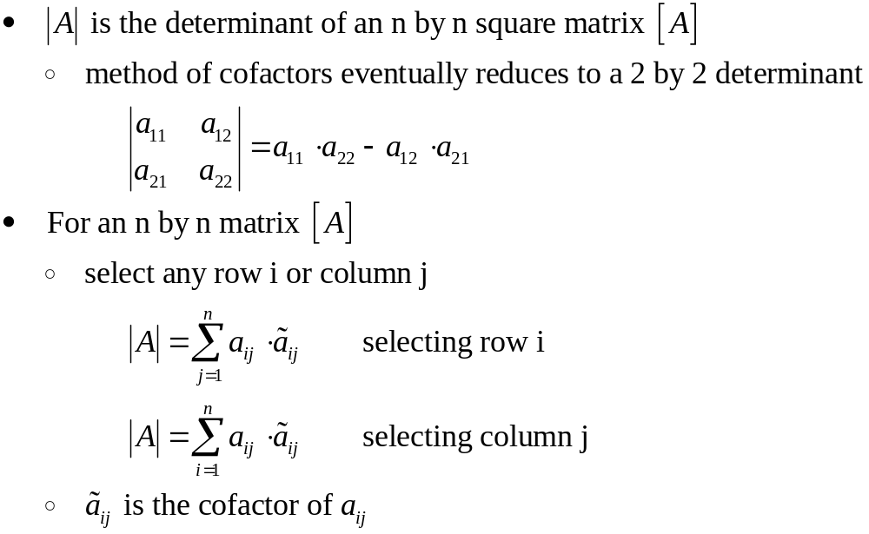
Determinant of a Matrix

Slide 10
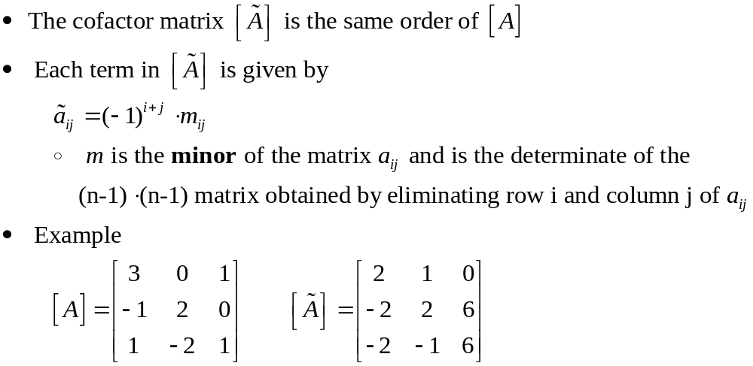
Cofactor Matrix

Slide 11
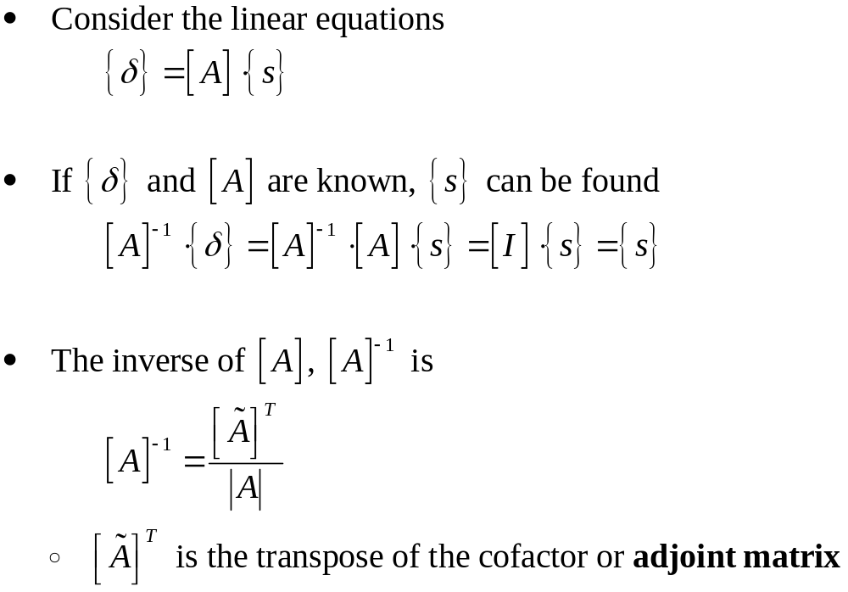
Matrix Inversion

Slide 12
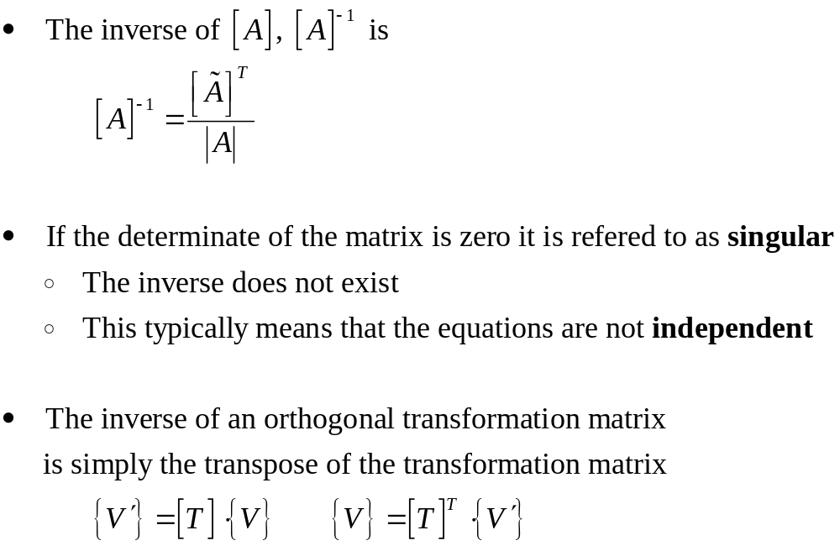
Special Cases of Matrix Inversion

Slide 13
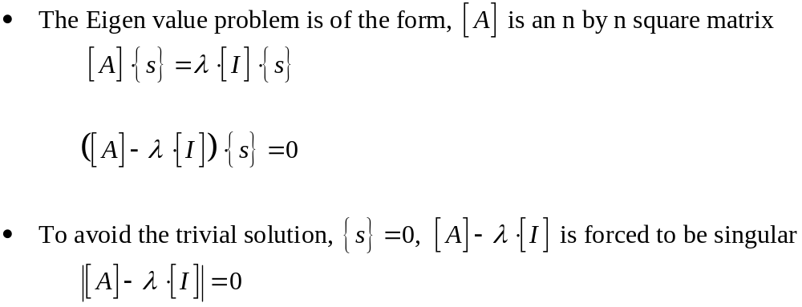
Eigenvalues and Eigenvectors

